Slide 1


Behaviour-Driven Development with StoryQ Liam McLennan Freelance Web Developer
liam.mclennan@gmail.com hackingon.net @liammclennan

Slide 2
Testing / Quality Assurance
The three ways to maintain release quality:
Automatic testing of all features ever implemented
Manual testing of all features ever implemented
Customer testing of features as they encounter them in production

Slide 3
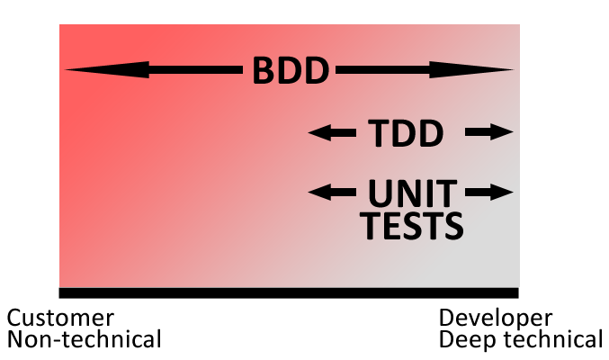
Some Automated Testing Strategies
Unit Tests / Test After
Test First (TDD)
Behaviour-Driven Development
Notes:
Unit test = Implementation verification
TDD = linking verification and design
BDD = linking verification and requirements

Slide 4

“Behaviour-driven development is about implementing an application by describing its behaviour from the perspective of its stakeholders”
Dan North

Slide 5
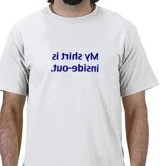
Features
Tests (specifications) are written outside-in, using the customer’s language and a simple test grammar.
Tests verify the intended behaviour, not the details of the implementation
The set of specifications becomes the authoritative system documentation.

Slide 6
Behaviour-Driven Development Workflow
Write a user story that delivers some value to the user
Define the behaviour using executable scenarios
Implement the behaviour until each scenario passes
Notes:
BDD is outside in.

Slide 7
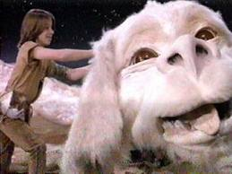
User Story / Feature / Requirement
Story is W
In order to X
As a Y
I want to Z

Slide 8
User Story
Story is Authenticate
In order to access secure resources
As an unauthenticated user
I want to sign in

Slide 9
Scenario / Acceptance Criteria
scenario [name]
given [some existing context]
when [this thing happens]
then [observe these results]

Slide 10
Scenario
scenario authenticate successfully
given a user with username “stevesmith”
and password “elvish”
when the user signs in using “stevesmith”/”elvish”
then they authenticate successfully

Slide 11
Scenario
scenario authentication failure
given a user with username “stevesmith”
and password “elvish”
when the user signs in using “stevesmith”/”password”
then authentication fails

Slide 12
Domain Specific Languages
Special purpose language
Internal or external
SQL
CSS

Slide 13
StoryQ
StoryQ is an internal DSL for writing, executing and documenting BDD specifications
http://storyq.codeplex.com/

Slide 14

Sign In
Story is Authenticate In order to access secure resources As an unauthenticated user I want to sign in
Feature authenticate = new Story("Authenticate") .InOrderTo("access secure resources") .AsA("unauthenticated user") .IWant("to sign in");
WE NEED THIS LATER

Slide 15

Create a Scenario
with scenario authenticate successfully given a user with username “stevesmith” and password “elvish” when the user signs in with “stevesmith”/”elvish” then they authenticate successfully
authenticate.WithScenario("authenticate successfully") .Given(AUserWithUsername, "stevesmith") .And(Password, "elvish") .When(TheUserSignsInWith,”stevesmith”,”elvish”) .Then(TheyAuthenticateSuccessfully) .Execute();
Notes:
Jump to StoryQ Converter
Write first specification
Show report

Slide 17

Story Time

Slide 18
User Story
Story is Authenticate
In order to not access secure resources
As an unauthenticated user
I want to fail to sign in

Slide 19
Scenario
with scenario authenticate with correct credentials
given a user with username “stevesmith”
and password “elvish”
when the user signs in using “stevesmith”/”elvish”
Then authentication fails

Slide 20

Meet the competition
MSPec http://github.com/machine/machine.specifications
Specflow http://www.specflow.org/
City beef or city chicken?

Slide 21

Still Don’t Get BDD?
http://dannorth.net/introducing-bdd
http://www.code-magazine.com/article.aspx?quickid=0805061

